Slide 1
Automated Shape Correspondence: Why and How
Doug Boyer
Duke University, Dept. of Evolutionary Anthropology

Slide 2
Outline
Goals & Rationale
Limitations of traditional landmarks
Definition of ‘automated correspondence’ & potential
Automated approaches and their limitations thus far
Auto3dgm: Concepts & Logistics
Homology and its relationship to correspondence
On the horizon

Slide 3
Goals & Rationale
Goal
To achieve data driven understanding of the pattern of micro- and macroevolution that describes the anatomical diversity of life.
Requirement
Quantitative approaches capable of meaningfully aligning and/or comparing “the same organ in different animals under every variety of form and function”
Rationale
Without such a framework, comparative morphology will remain arbitrarily limited in its ability to quantitatively describe the morphological (and potentially evolutionary) continuity uniting different individuals and species.

Slide 4
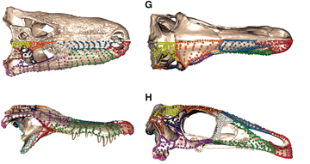
Limitations of traditional landmarks
Time consuming for richly corresponding shapes
Inadequate coverage → instable shape characterization

Slide 5
Limitations of traditional landmarks
Time consuming for richly corresponding shapes
Inadequate coverage → instable shape characterization
Watanabe, 2018 (PLoS)

Slide 6
Limitations of traditional landmarks
Time consuming for richly corresponding shapes
Inadequate coverage → instable shape characterization
Watanabe, 2018 (PLoS)

Slide 7
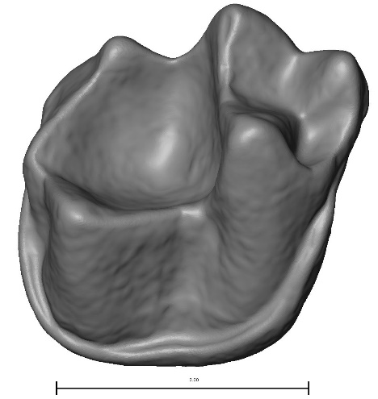
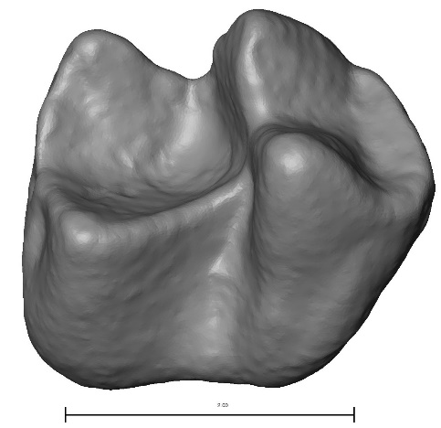
Limitations of traditional landmarks
2) Data to represent shape must be chosen a priori, maybe subjectively
“As a general rule, landmarks should be chosen so you can quantify any differences that you can see” (Zelditch et al., 2004)
?

Slide 8
Limitations of traditional landmarks
3) Criterion of homology can be difficult to substantiate in practice
Leads to differing interpretations of homologous points
Also expressed as inflated inter- or intraobserver error
?

Slide 9
Limitations of traditional landmarks
4) Cannot be used for “topology” changes
i.e., differences reflecting missing features will not be quantified (Zelditch et al., 2004)
Coverage will not be adequate (Watanabe, 2018)
too few landmarks
Landmarks not repeatable
?

Slide 10
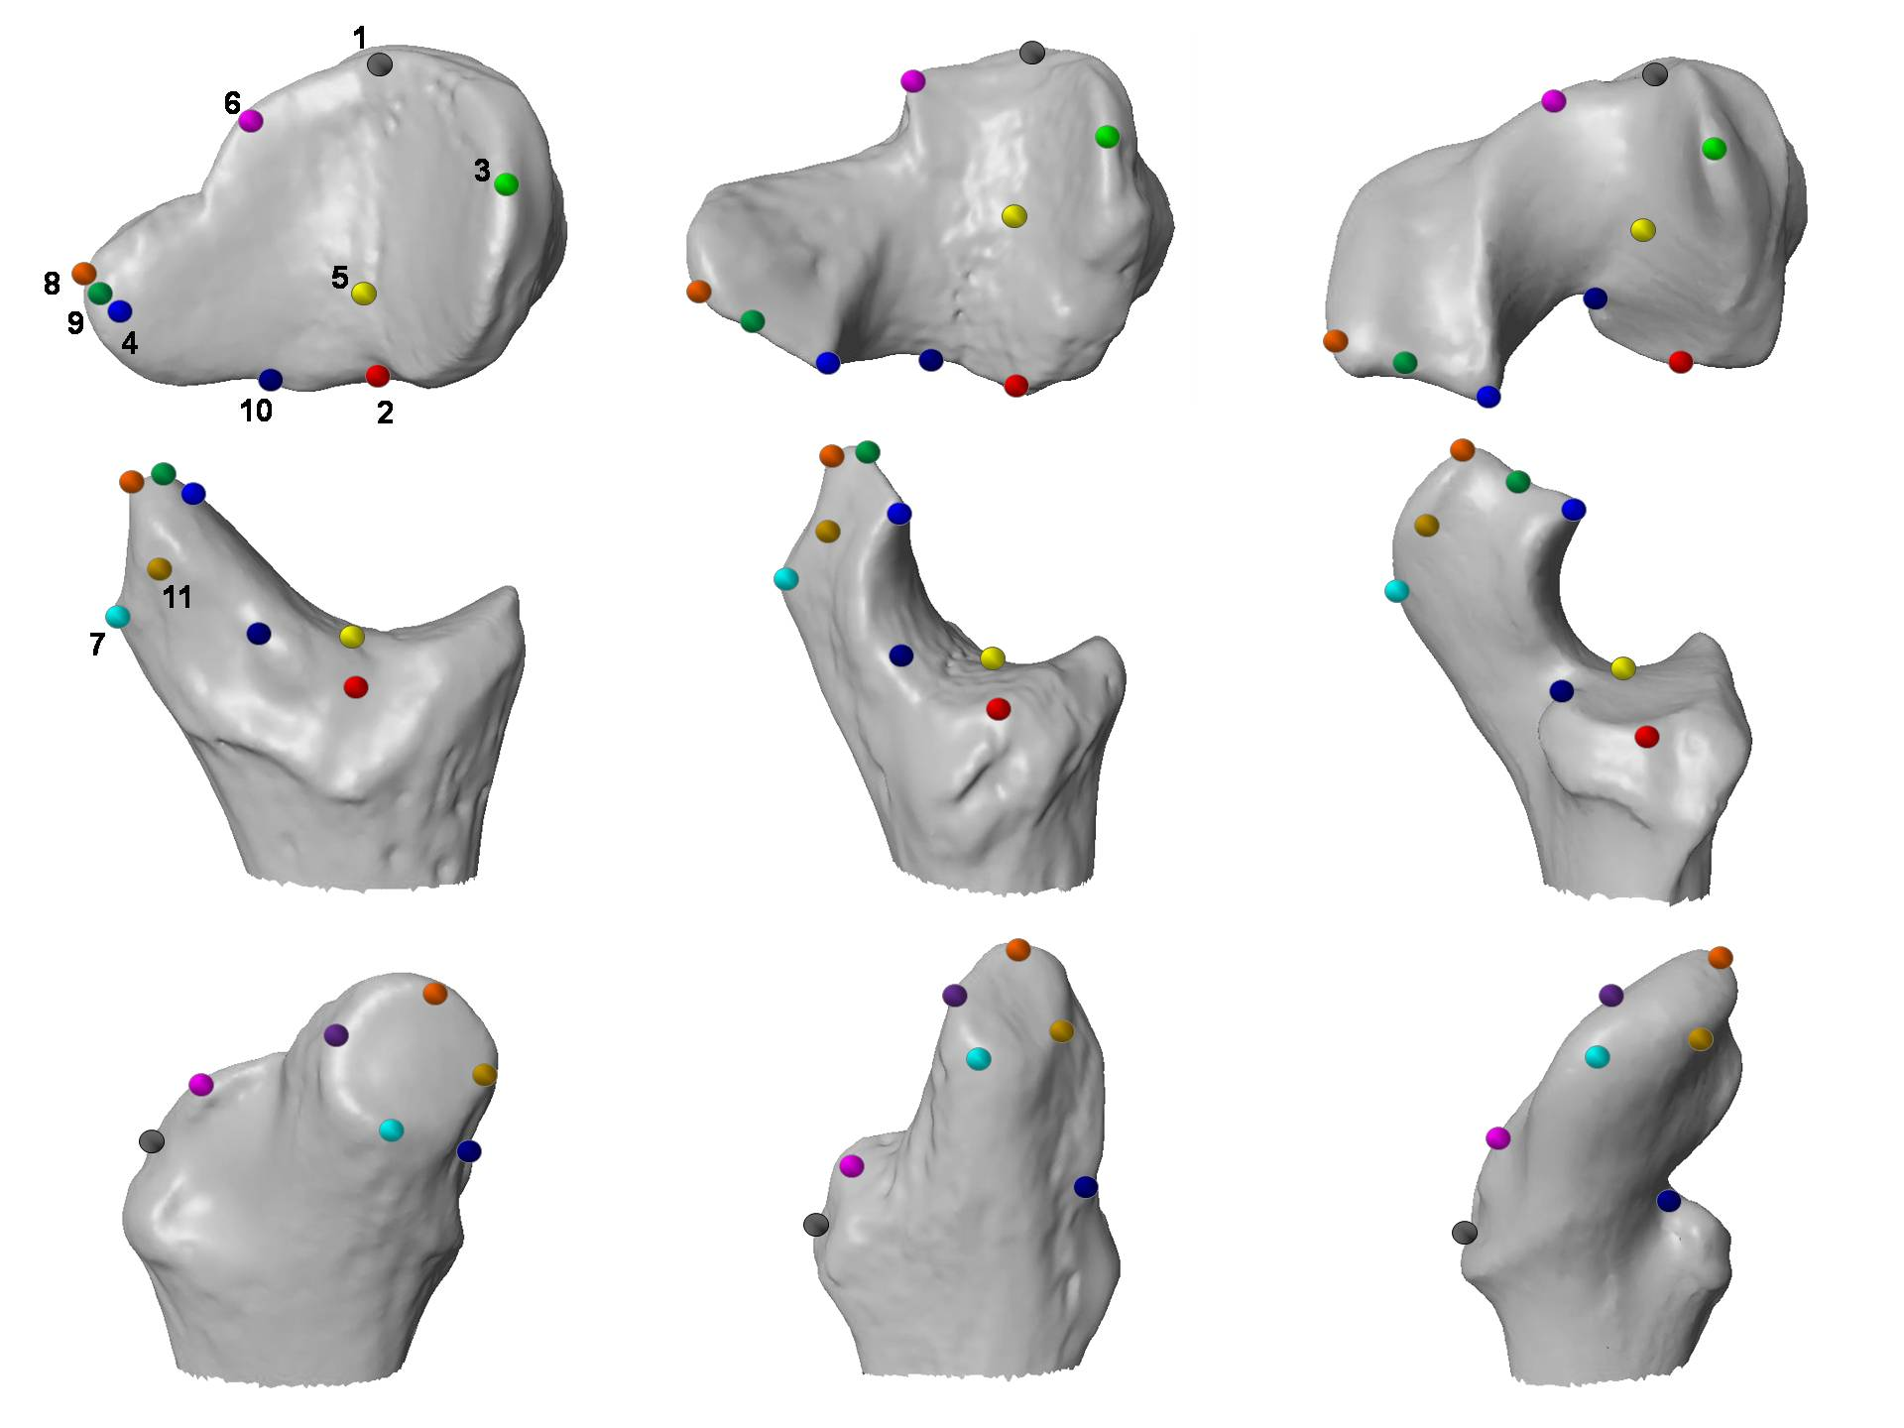
Limitations of traditional landmarks
4) Cannot be used for “topology” changes
i.e., differences reflecting missing features will not be quantified (Zelditch et al., 2004)
Coverage will not be adequate
too few landmarks
Landmarks not repeatable
Boyer et al., 2011

Slide 11
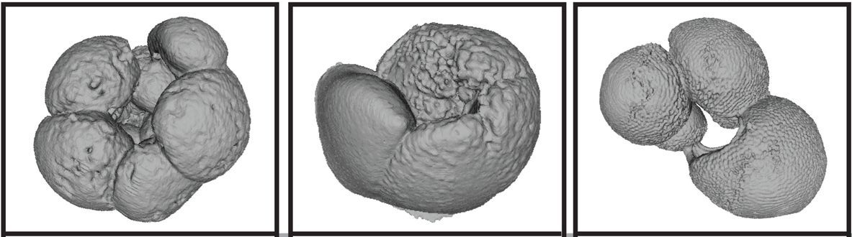
Limitations of traditional landmarks
4) Cannot be used for “topology” changes
i.e., differences reflecting missing features will not be quantified (Zelditch et al., 2004)
Coverage will not be adequate
too few landmarks
Landmarks not repeatable
Hsiang et al., 2016

Slide 12
Definition of ‘automated correspondence’
“biologically meaningful (possibly homologous) points are identified between pairs of digitized structures without human intervention except through manipulation of the algorithm parameters”

Slide 13
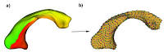
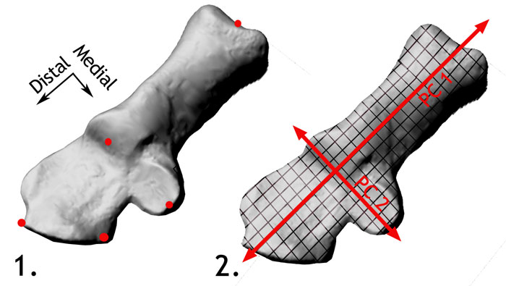
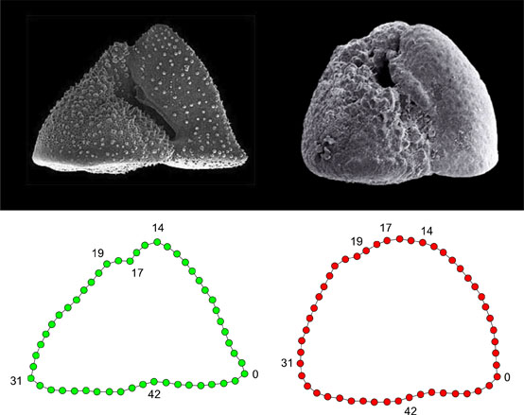
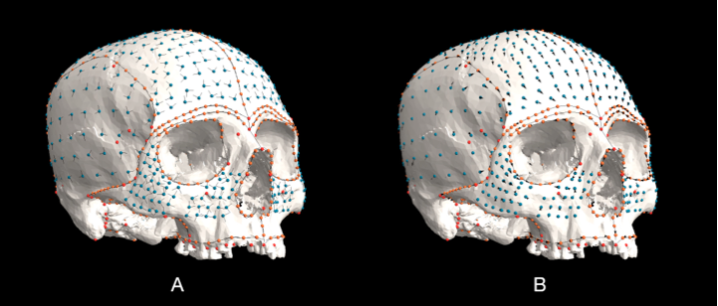
Initial Progress
Semi-automated methods
Lohmann 1983, Weeks 1999, various papers in MacLeod 2007, Polly & MacLeod 2008, Sievwright et al. 2012, Mitteroeker & Gunz 2009
Automated methods restricted to conservative samples
Thirion & Guordon 1996, Subsol et al. 2002, Styner et al. 2006, Paniagua et al. 2012
Notes:
Expand on MacLoed and Polly

Slide 14
Automated approaches and their limitations thus far
Require an observer to supply an orientation or initial guess
For photography (to work from 2D images)
For choosing a orientation (Eigensurface of Polly & MacLeod, 2008)
Aligning “crest lines” (Thirion & Guordon, 1995; Subsol et al., 2002)
Expect minimal variation
Clinical work on human-only samples (Styner et al. 2003)
Work with model animals (intraspecific variation)
Computationally prohibitive
- Biggest hurdle is finding correct initial alignment for diverse samples (e.g., Iterative Closest Points algorithm)

Slide 15
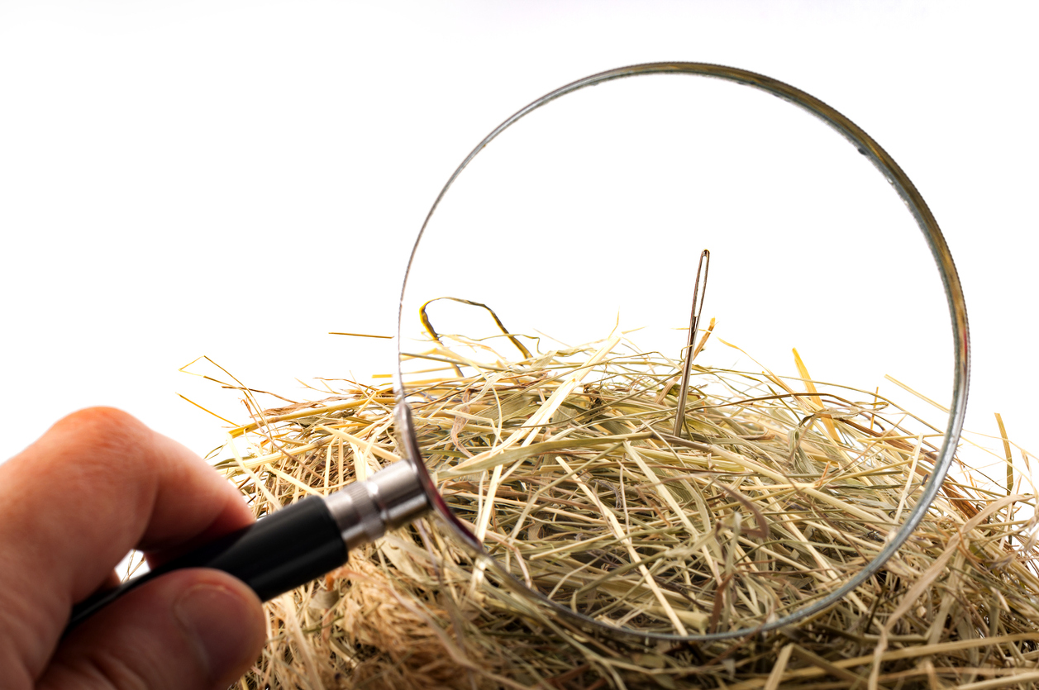
Solution (?)
Identify ways to reduce # of likely candidate alignments and correspondences a priori
Utilize Procrustes to find the ‘best’ among the candidates.

Slide 16
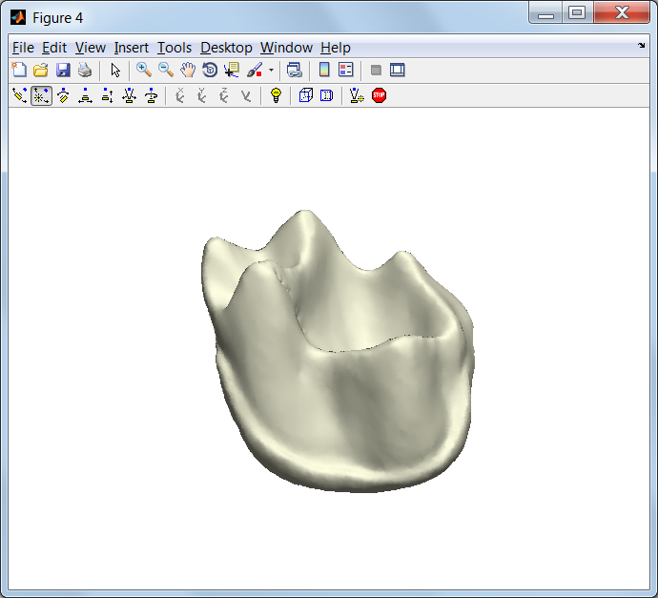
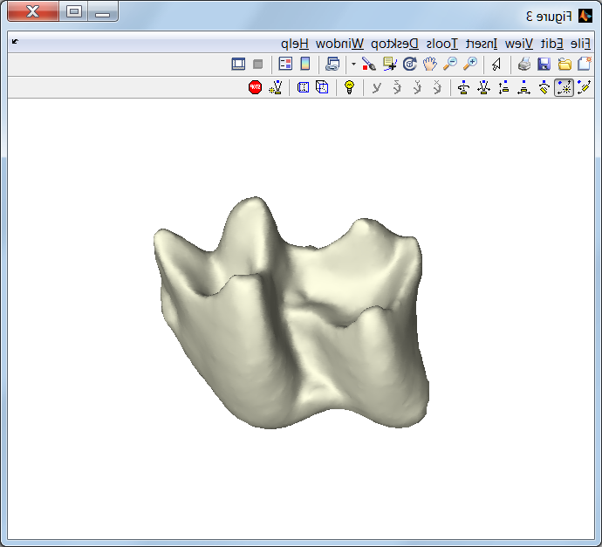
Standard Procrustes Distance
“qualitatively determined”

Slide 17
Standard Procrustes Distance
“qualitatively determined”
Find rigid motions (translation & rotation) that minimize sum distance

Slide 18
Modified Procrustes Distance
Standard Procrustes Distance
is not specified apriori
Find Correspondence map (C) that minimizes sum distance, allowing any set of rigid motions
Notes:
18

Slide 19
Modified Procrustes Distance
Find C with minimum Procrustes
5 points = 120 possiblities….
10 points = 3.6 million possibilities
?

Slide 20
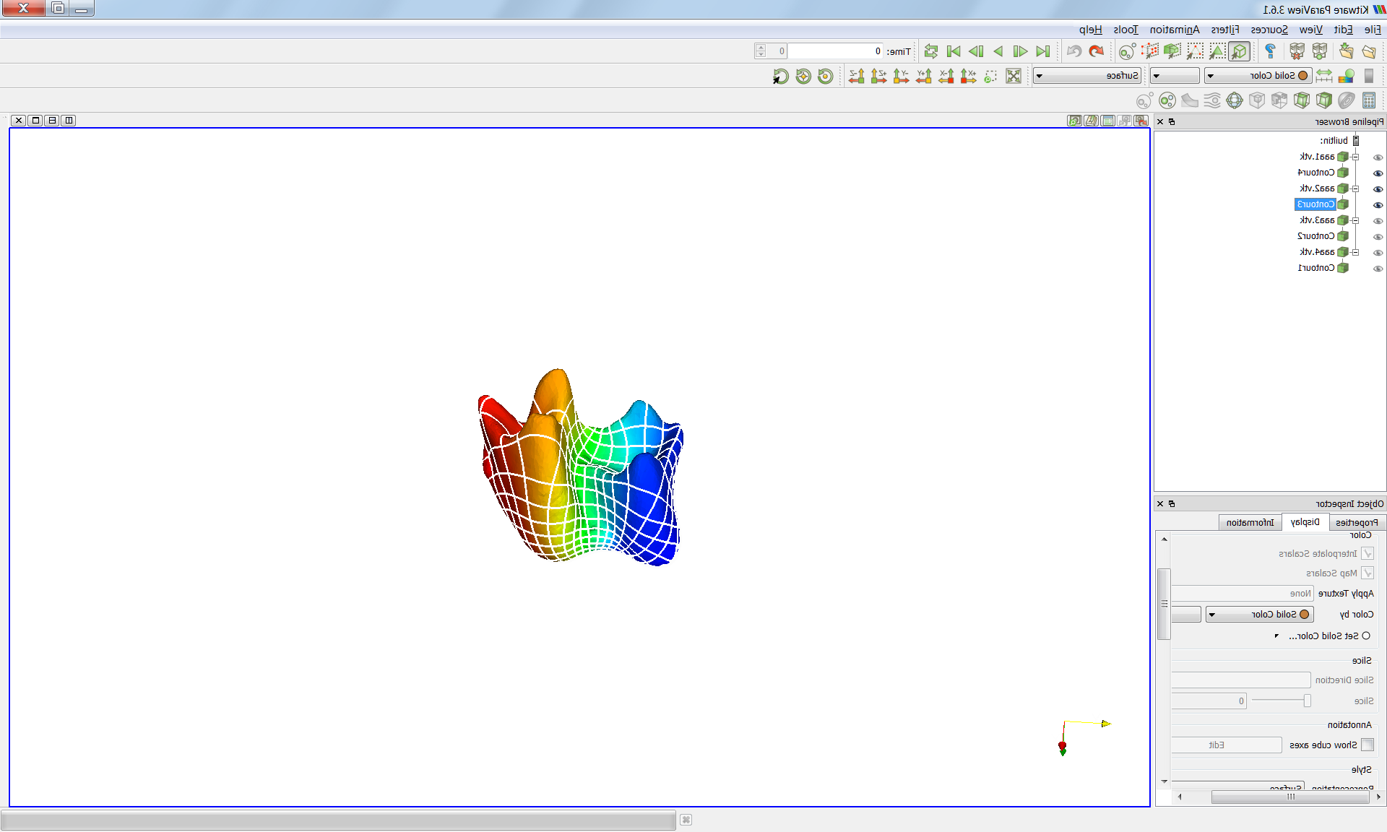
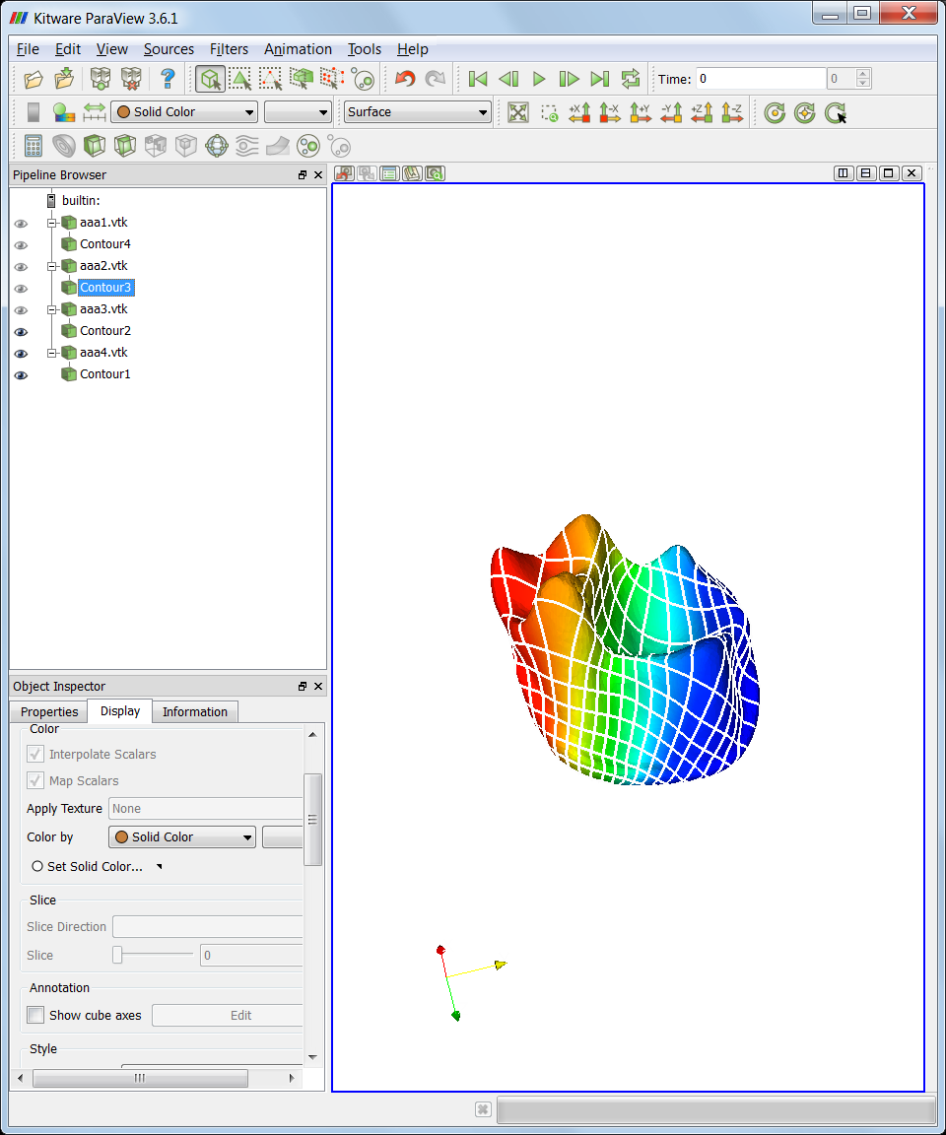
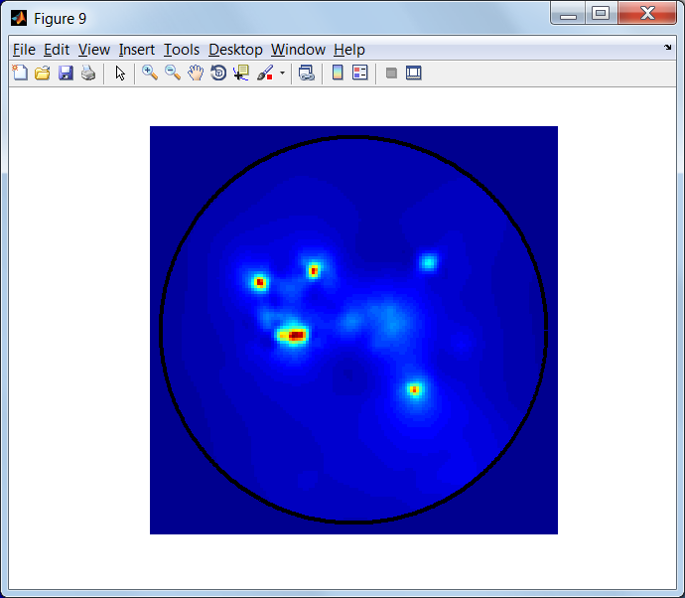
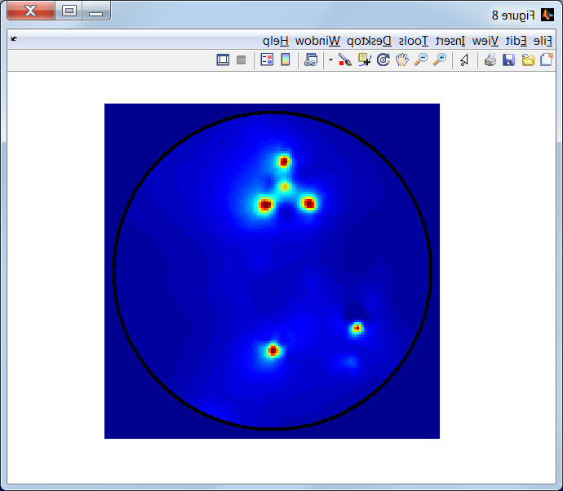
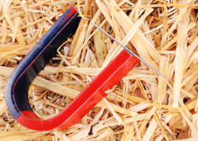
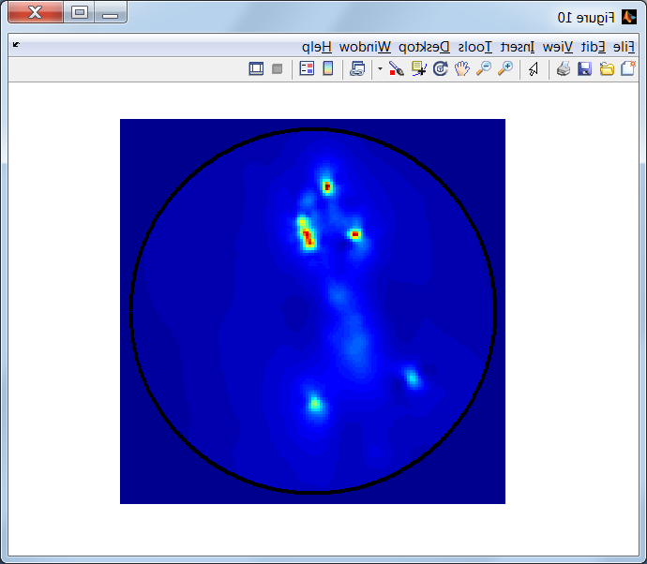
?
Search area of
Correspondence
Maps…
Degrees of freedom
Computationally difficult
TPS
Mӧbius Maps
3 Degrees
Boyer et al. 2011 (PNAS)

Slide 21
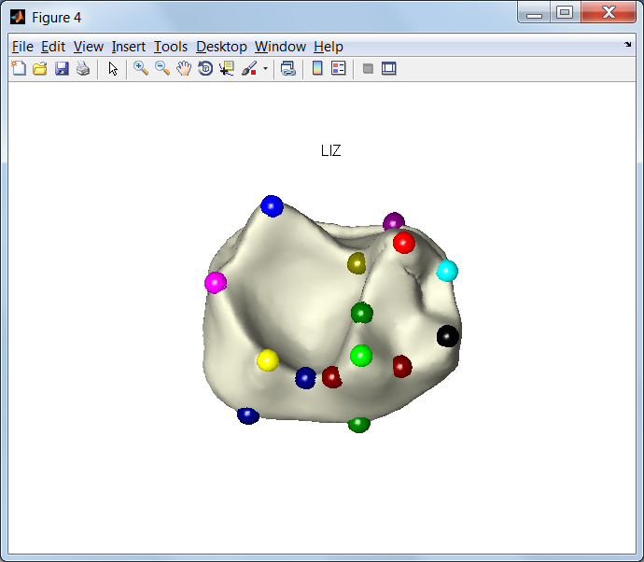
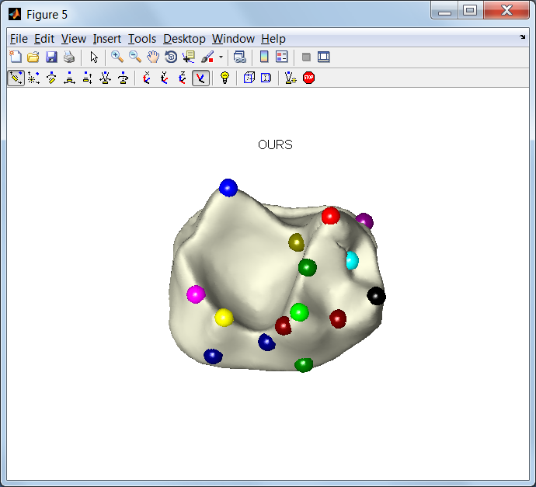
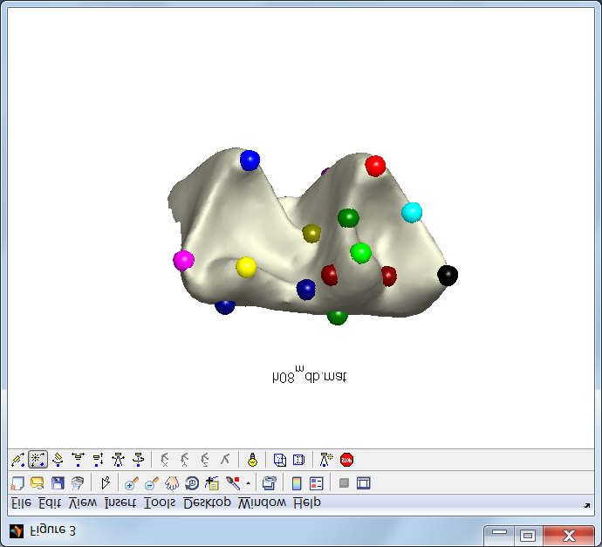
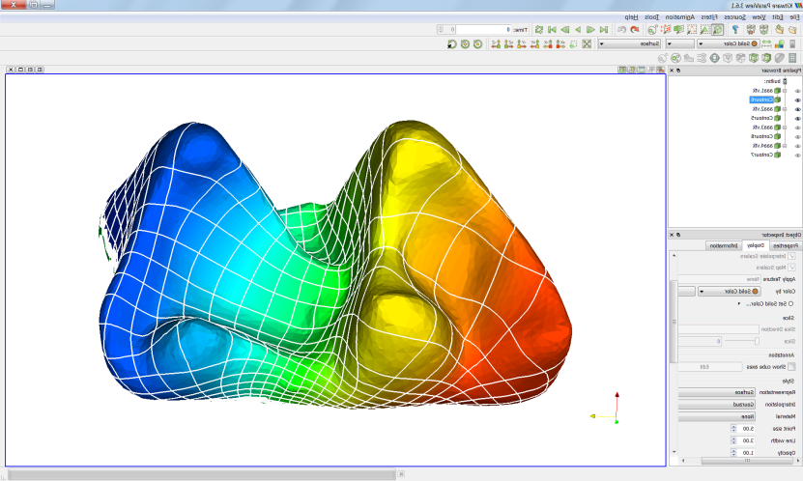
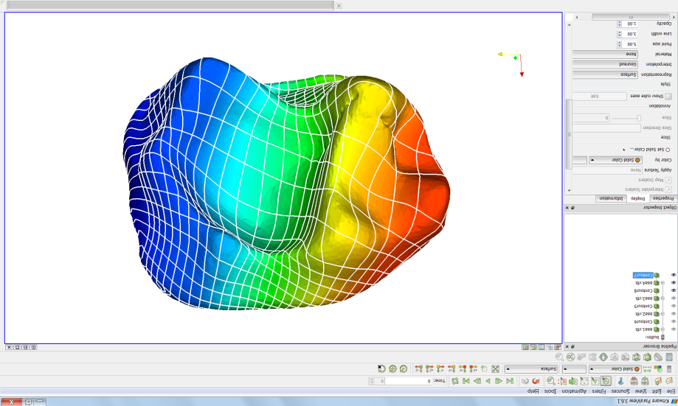
Results Compare to Observer Landmarks
Observer-placed in
Landmark Editor
Computer-placed
Computer
correspondence
map
Boyer et al. 2011 (PNAS)

Slide 22
Results Compare to Observer Landmarks
Observer-placed in
Landmark Editor
Computer-placed
Boyer et al. 2011 (PNAS)

Slide 23
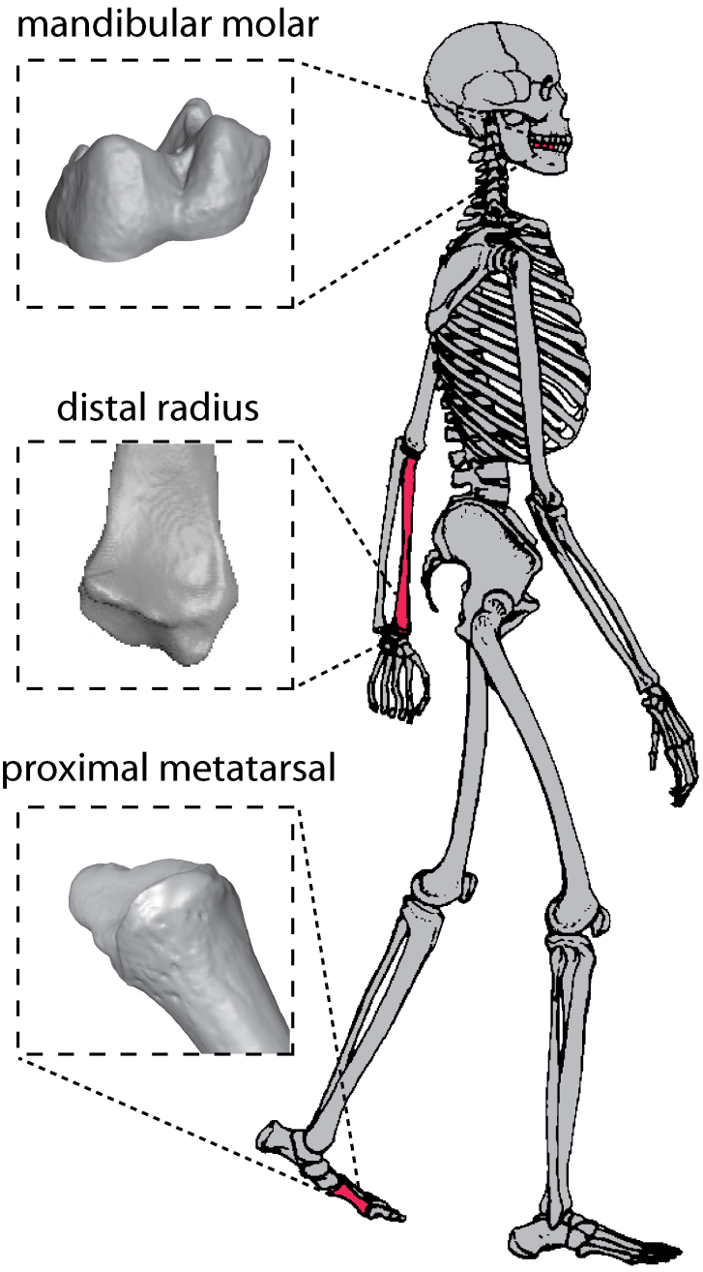
CLASSIFICATION ANALYSIS
3 data sets (mainly primates)
116 mandibular 2nd molars
5 orders, 19 families, 35 genera
45 distal radii
1 order, 2 families, 4 genera
61 proximal first metatarsals (Mt1)
1 order, 9 families, 13 genera
Boyer et al. 2011 (PNAS)
Notes:
23

Slide 24
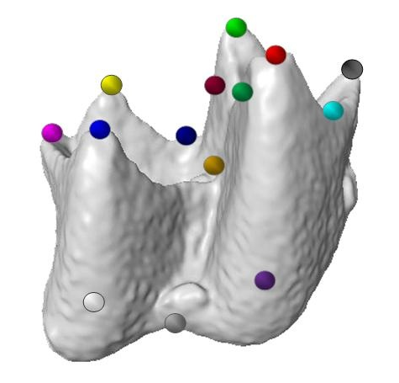
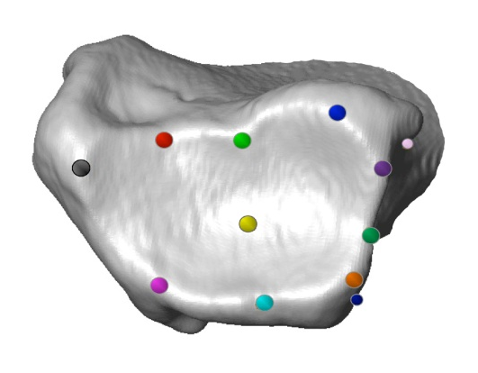
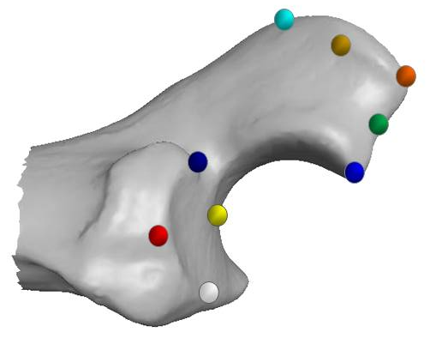
HUMAN correspondences
Same 3 data sets: Geometric landmarks applied
116 mandibular 2nd molars
5 orders, 19 families, 35 genera
16 Landmarks
45 distal radii
1 order, 2 families, 4 genera
13 Landmarks
61 proximal Mt1
1 order, 9 families, 13 genera
11 Landmarks
Boyer et al. 2011 (PNAS)
Notes:
24

Slide 25
Results
Classification success (mean % correct per genus)
Dataset | HUMAN correspondences | COMPUTER correspondences
Teeth 24 grps | 90% | 90%
Radii 5 grps | 86.94% | 97.50%
Mt1 13 grps | 73.15% | 75.07%
Boyer et al. 2011 (PNAS)
Notes:
25

Slide 26
Results
Classification success (mean % correct per genus)
Dataset | HUMAN correspondences | COMPUTER correspondences
Teeth 24 grps | 90% | 90%
Radii 5 grps | 83% | 88%
Mt1 13 grps | 73.15% | 75.07%
Boyer et al. 2011 (PNAS)
Notes:
26

Slide 27
Results
Classification success (mean % correct per genus)
Dataset | HUMAN correspondences | COMPUTER correspondences
Teeth 24 grps | 90% | 90%
Radii 5 grps | 83% | 88%
Mt1 13 grps | 76% | 82%
Boyer et al. 2011 (PNAS)
Notes:
27

Slide 28
Results
Classification success (mean % correct per genus)
Dataset | HUMAN correspondences | COMPUTER correspondences
Teeth 24 grps | 90% | 90%
Radii 5 grps | 83% | 88%
Mt1 13 grps | 76% | 82%
Boyer et al. 2011 (PNAS)
Notes:
28

Slide 29
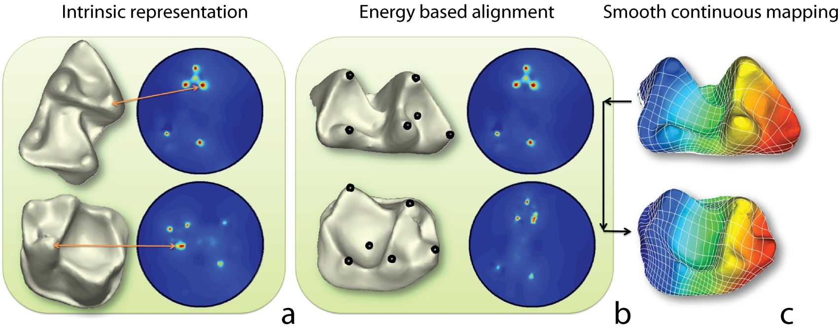

Initial Progress
First automated correspondence algorithm in 3D (Boyer et al. 2011)
Tested on three samples of surface models (teeth, radii, metatarsals)
Compared to traditional landmark data sets on same samples
Results
Produced plausible correspondence maps
Automatically determined distances correlated as strongly with taxonomic differences as distances based on manually-collected data.

Slide 30
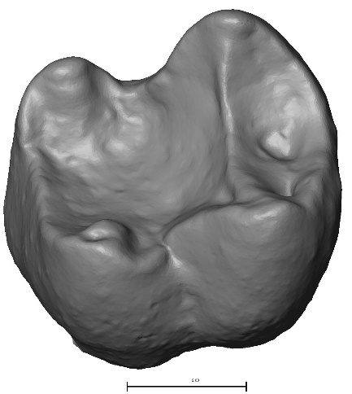
Initial Progress
Limitations
Difficult to work with Matlab code
Correspondence determinations non-transitive
Poor alignment with most dissimilar shapes

Slide 31
Auto3dgm: Concepts & Logistics
Similar objects are easy to align automatically
Use a graded series of similar objects to align dissimilar endmembers
Exists as R, matlab, and now Python / Slicer routines.
Transitive correspondences
Output includes a landmark file that can be analyzed with standard 3d geometric morphometric software (including Morphologika, MorphoJ and SlicerMorph)
Can be used for alignment of 3D models
Provides a way to compare magnitude of variation between two samples

Slide 32
Auto3dgm: Publications
Methodological/validation
Boyer et al. (2015): https://onlinelibrary.wiley.com/doi/full/10.1002/ar.23084
Boyer et al. (2016): https://onlinelibrary.wiley.com/doi/abs/10.1002/ar.23202
Gonzalez et al. (2016): https://onlinelibrary.wiley.com/doi/abs/10.1002/ajpa.22934
Gao et al. (2017): https://onlinelibrary.wiley.com/doi/abs/10.1002/ar.23700
Gao et al. (2018): https://arxiv.org/pdf/1807.11887.pdf
Applications (e.g):
Turner et al. (2014): https://doi.org/10.1093/imaiai/iau011
Sieffert et al. (2015): https://peerj.com/articles/1036/
Hsiang et al. (2016): http://rstb.royalsocietypublishing.org/content/371/1691/20150227
Gingerich (2016): https://link.springer.com/article/10.1007/s12542-017-0362-8
Boyer et al. (2017): https://www.sciencedirect.com/science/article/pii/S0047248417301021
Vitek et al. (2017): https://onlinelibrary.wiley.com/doi/abs/10.1002/ece3.3058
Renaud et al. (2017): https://www.sciencedirect.com/science/article/pii/S0003996917301383?via%3Dihub
Renaud et al. (2018): https://link.springer.com/article/10.1007/s11692-018-9459-6
Boyer et al. (2018): https://www.sciencedirect.com/science/article/pii/S0047248417305134
Gunnell et al. (2018): https://www.nature.com/articles/s41467-018-05648-w
Wang et al. (2019): https://www.biorxiv.org/content/10.1101/701391v1

Slide 33
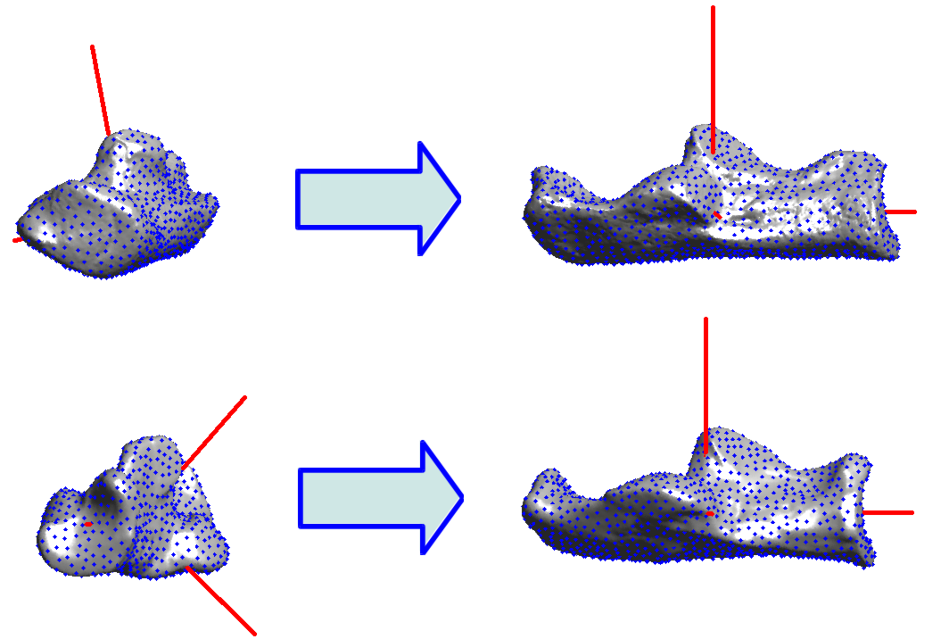
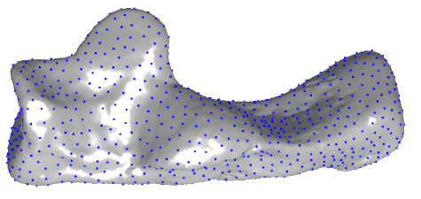
Steps to the method
Processing and initial alignment
Re-sample surface + size-standardize point cloud (Eldar et al. 1997)
Compute principle axes with PCA
Begin “alignment search”
Principle axes (8 possibilities)
Iterative closest points: Compute euclidean motions that minimize procrustes distance (PCD) (Besl & McKay 1992)

Slide 34
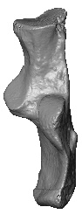
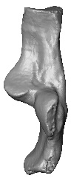
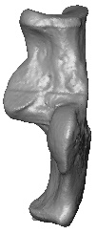
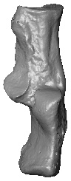
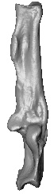
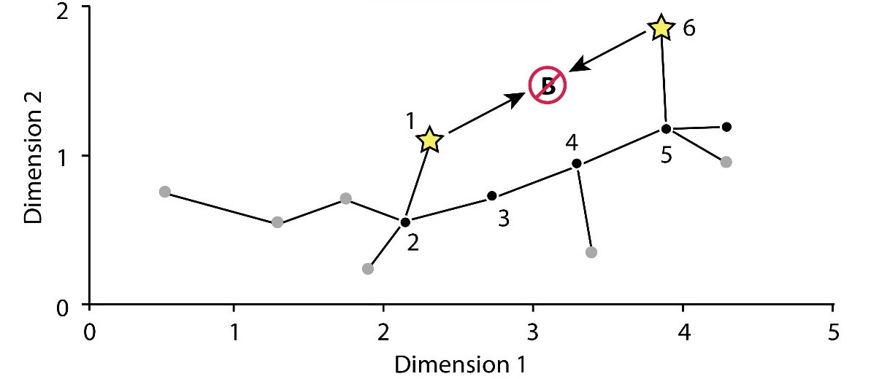
Steps to the method
PCD matrix
Alignment refinement
Compute Procrustes for all pairs
Determine minimum spanning tree (MST)
Propagate correspondences through MST for transitivity
0
0.2
0.3
0.2
0.6
0
0.2
0.1
0.5
0
0.3
0.6
0
0.4
0

Slide 35
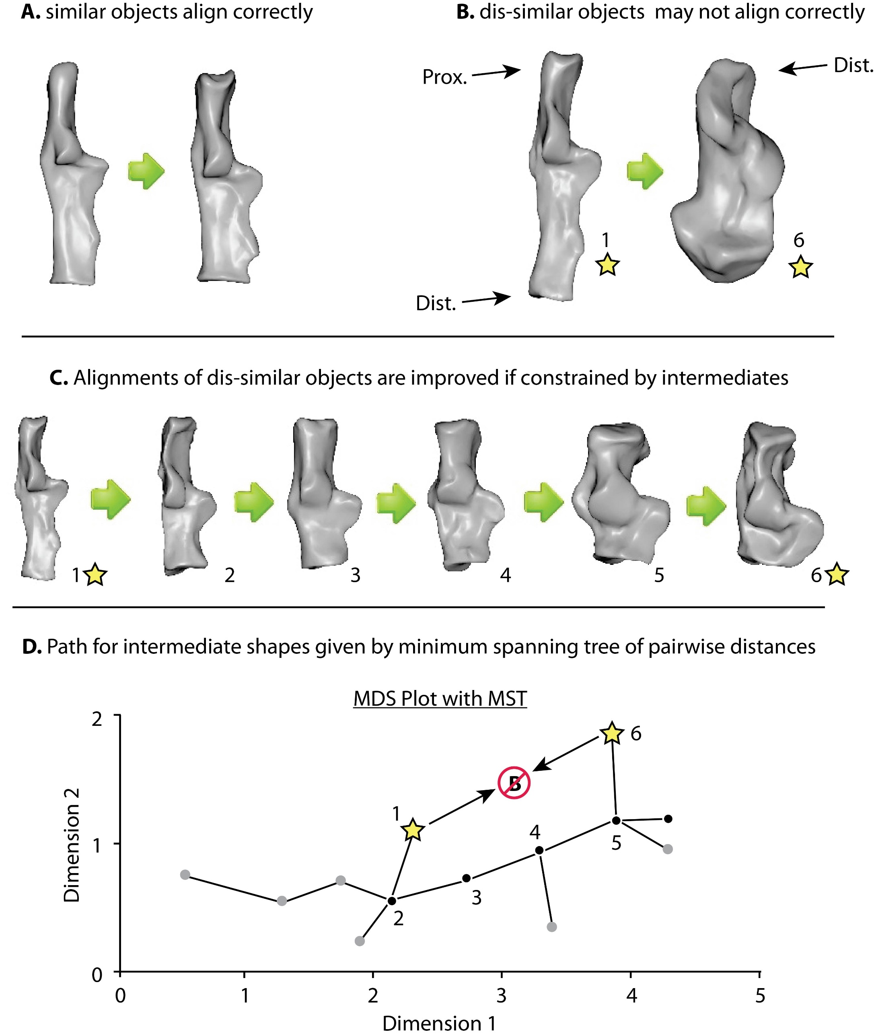
Purpose of MST & Propagation
Similar shapes align well
Dissimilar shapes may align incorrectly
PCD = 0.1
PCD = 0.7
All Procrustes distances used to construct initial minimum spanning tree

Slide 36
Purpose of MST & Propagation
Similar shapes align well
Dissimilar shapes may align incorrectly
PCD = 0.1
PCD = 0.7
Incorrect alignments typically have high PCD and won’t be in the MST

Slide 37

Purpose of MST & Propagation
Similar shapes align well
Dissimilar shapes may align incorrectly
PCD = 0.1
PCD = 0.7
The MST path can be used to find correct alignments, and recompute distances

Slide 38
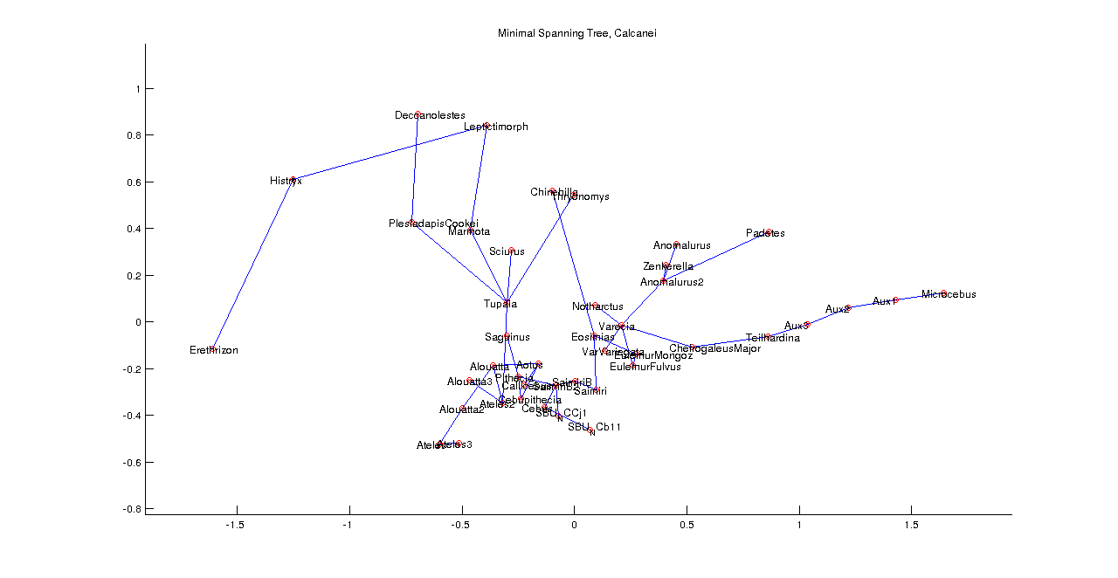
MST w initial correspondences

Slide 39
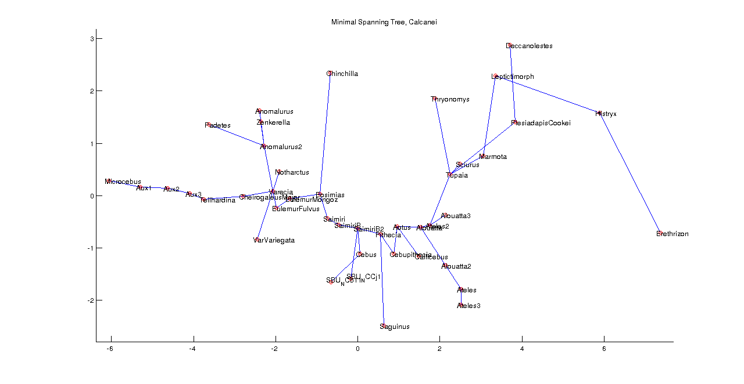
MST w transitive correspondences

Slide 40
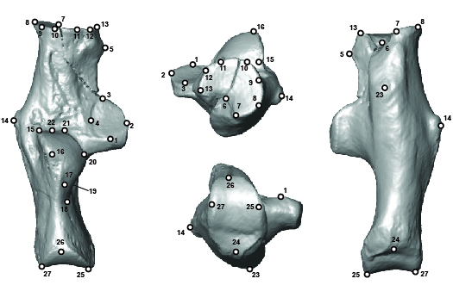
Comparison to researcher-based data set
Sample - 106 calcanei
Data points
Observer (27 landmarks)
Algorithm (1,024 points)
Software
Morphologika2.5
Both datasets analyzed identically
From Gladman et al. (2013)

Slide 41
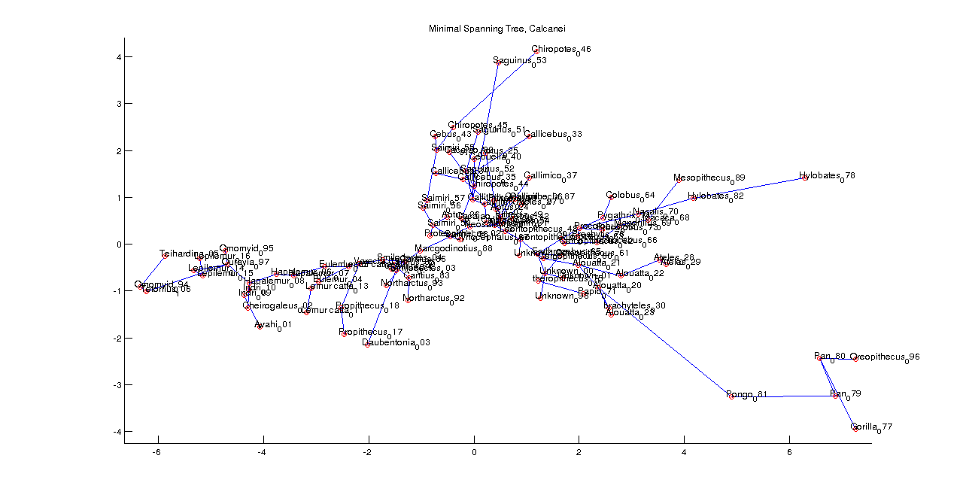
Results
South American monkeys
Old World Monkeys
lemurs & fossils
Apes

Slide 42
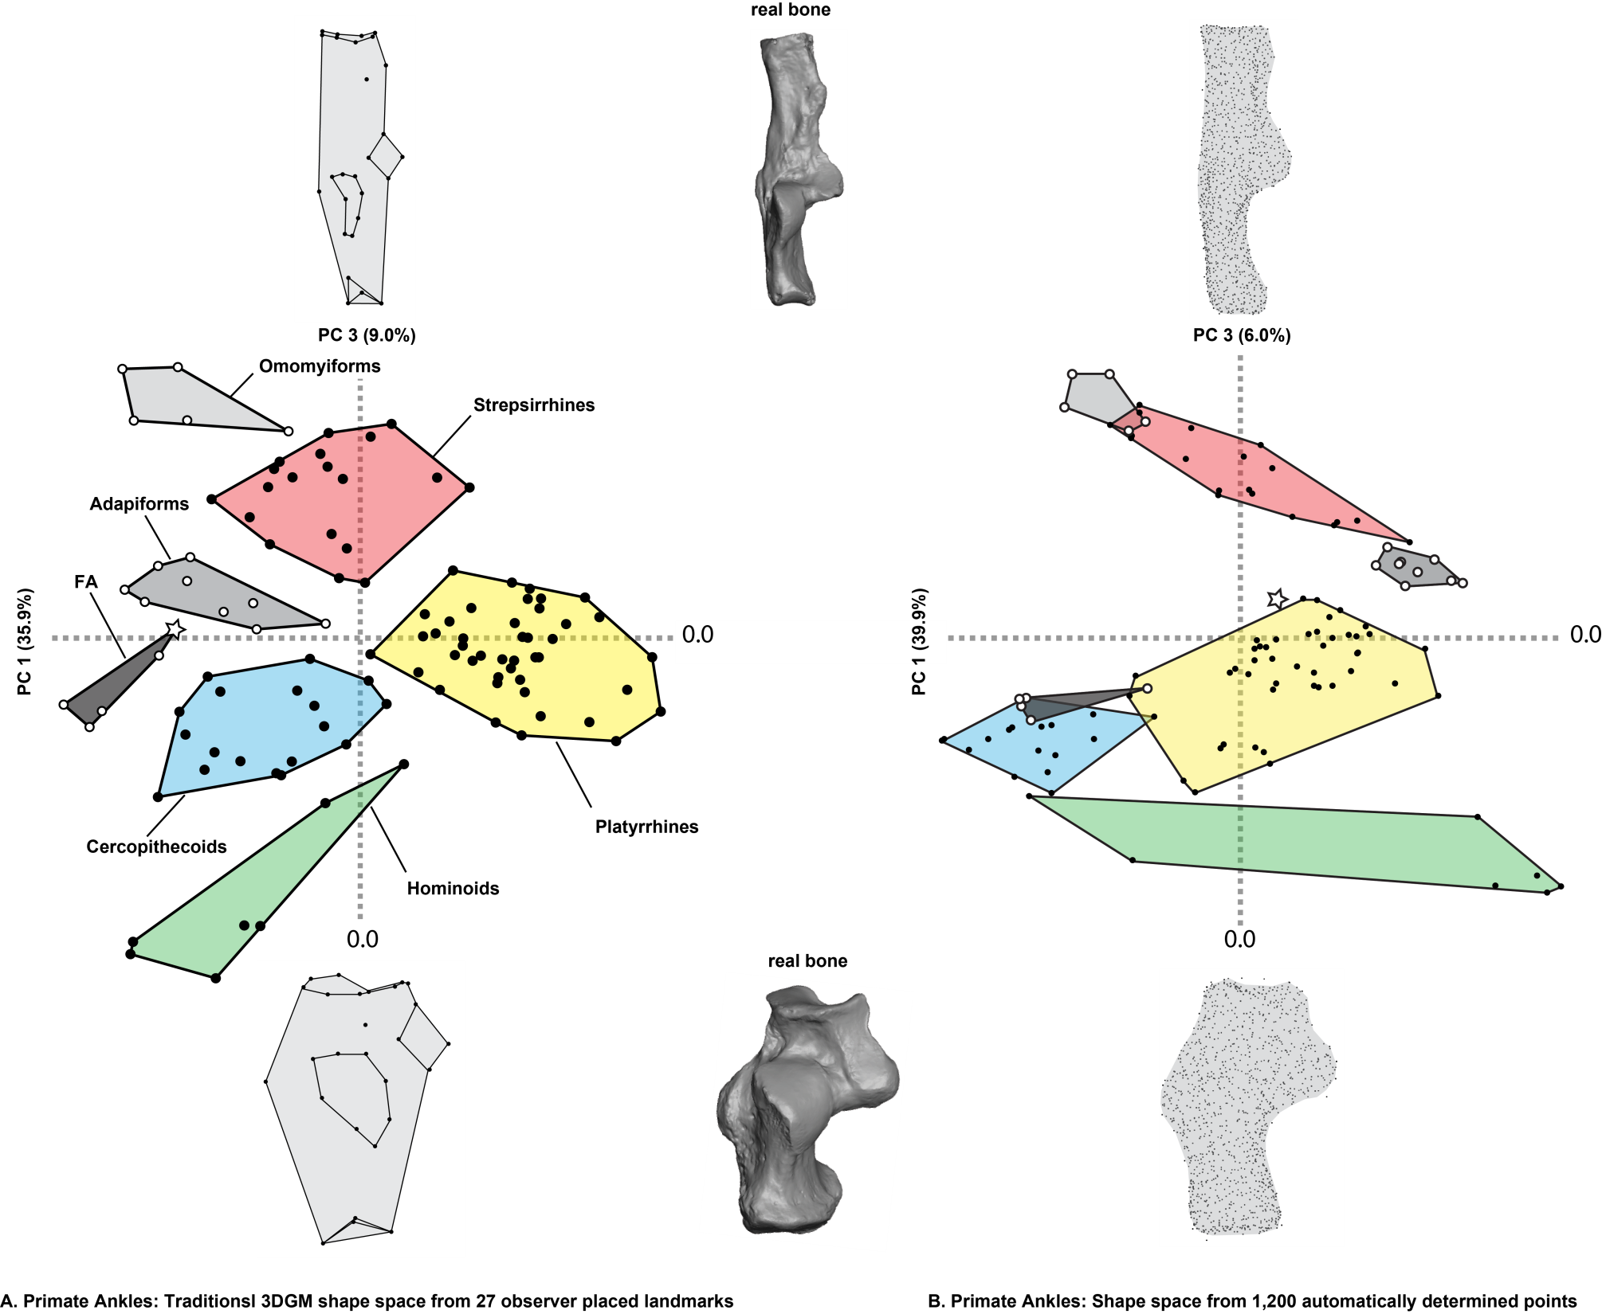
Results

Slide 43
Difficult example
claws
nails
Boyer et al. (2018)

Slide 44
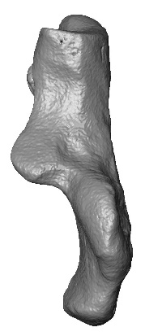

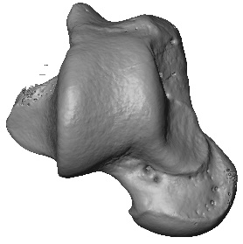
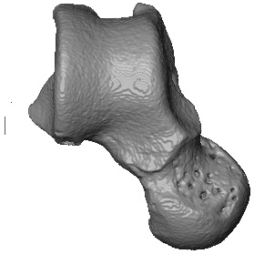

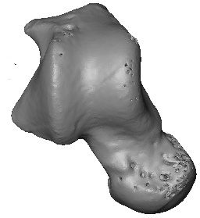

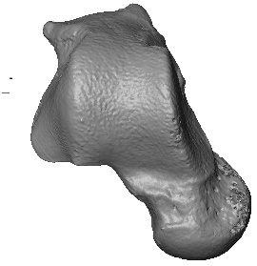

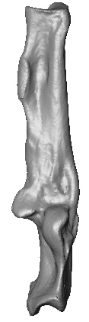
Comparison between bones
versus

Slide 45


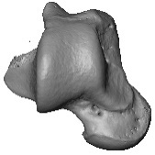
Steps to the method
Use standard number of points in each sample
Analyze each bone type separately
Compute Procrustes minimum distance for all pairs astragali+calcanaei
Link minimum spanning trees using pair with smallest PCD

Slide 46








Steps to the method
PCD matrix
Yields global landmark dataset that applies to both bone types
Combined distance matrix
Procrustes alignment and PCA can be run on mixed bone sample
Example
80 calcanei and 80 astragali
Taxon matched
Stats
Compare morphospace area
Proxy for disparity
Compare phylogenetic signal
Tree from 10k trees website
Check for correlations in PCA
0 | 0.2 | 0.3 | 0.2 | 0.6 | 0.7 | 0.8 | 0.9 | 0.7 | 1.0
 | 0 | 0.2 | 0.1 | 0.5 | 0.8 | 0.9 | 0.8 | 0.8 | 1.0
 |  | 0 | 0.3 | 0.6 | 0.6 | 0.8 | 0.7 | 0.8 | 0.9
 |  |  | 0 | 0.4 | 0.7 | 0.8 | 0.7 | 0.9 | 1.1
 |  |  |  | 0 | 1.1 | 1.0 | 1.1 | 1.1 | 1.2
 |  |  |  |  | 0 | 0.1 | 0.2 | 0.1 | 0.3
 |  |  |  |  |  | 0 | 0.3 | 0.2 | 0.4
 |  |  |  |  |  |  | 0 | 0.3 | 0.5
 |  |  |  |  |  |  |  | 0 | 0.3
 |  |  |  |  |  |  |  |  | 0

Slide 47

Results

Slide 48
Results
Stats
PC1-2 plot area
Calcaneal data occupy 30% more area
Variance
Equal magnitude in calcaneal and astragalar samples
Higher magnitude in combined samples
Phylogenetic signal (Pagel’s ʎ)
Higher in calcaneal data than astragalar
Higher magnitude in combined samples
Correlations
For a taxon, PC1 score of calcaneus highly correlated with PC1 score of astragalus

Slide 49



Other stuff…
Some other properties/limitations
Only small deformations allowed (some definitions of homology/correspondences violated)
What we want (?)

Slide 50
Other stuff…
Some other properties/limitations
Only small deformations allowed (some definitions of homology/correspondences violated)
What we get (with auto3dgm)

Slide 51
Homology and correspondence
Are they the same thing?
“The same organ in different animals under any variety of form and function” (Owen, 1843)
“biological homology refers to unitary structures; not to the infinitesimal coordinate locations on structures that can be defined under the concept of geometric homology” (MacLeod, 2001)

Slide 52
Homology
Kinds of Homology
Transformational (aka ‘genealogical’ or ‘Darwinian’)
Serial (homologous by developmental duplication)
Operational (hypothesis for the purpose of communication or measurement)
Taxic (variation in transformational homologous features)

Slide 53


Homology
Biological homology & geometric homology converge nicely in a skull

Slide 54


Homology of facet boundaries as ‘type 1’
Left humerus, distal end, anterior view
Bonn-Divett et al. (2019)
Left talus, dorsal view
Barnet (1954)

Slide 55
Homology of facet boundaries as ‘Type 1’
?
Left humerus, distal end, anterior view
Bonn-Divett et al. (2019)
Left talus, dorsal view
Barnet (1954)

Slide 56

Homology of tooth cusps
M1
P4
P3
M2
M3
P2
?

Slide 57
Homology of tooth cusps
Homology & correspondence interpretations are influenced by sample & the inferred relationships of species in it.
Therefore, correspondence hypotheses should emerge from analyses, not be predetermined.
(Van Valen, 1982)

Slide 58
On the horizon
Feature-aware mappings that are transitive
Boyer et al. 2011 (PNAS)

Slide 59
On the horizon
Feature-aware mappings that are transitive
Probablistic correspondence
Identify and compare ‘corresponding regions’ rather than points
Entertain mappings where ‘regions’ are lost or gained (i.e., not all regions need to be present in every object).
Could resolve issues identified for using GM in phylogenetic analysis (e.g, MacLoed, 2001)

Slide 60




Disputed homologies in Lepilemur
Swindler 2004
?
Microcebus
Lepilemur
Boyer et al. 2011 (PNAS)
Notes:
60

Slide 61
Disputed homologies in Lepilemur
Swindler 2004
Entoconid
Microcebus
Lepilemur
Boyer et al. 2011 (PNAS)

Slide 62
Disputed homologies in Lepilemur
Swindler 2004
Schwartz & Tattersall 1985
Entoconid
X
Metastylid
Microcebus
Lepilemur
Boyer et al. 2011 (PNAS)
Notes:
62

Slide 63
Why the difference?
Swindler 2004
Schwartz & Tattersall 1985
Entoconid
X
Metastylid
Microcebus
Lepilemur
Boyer et al. 2011 (PNAS)

Slide 64
Comparisons to a different taxon
Megaladapis
Swindler 2004
Schwartz & Tattersall 1985
Entoconid
X
Metastylid
Microcebus
Lepilemur
Boyer et al. 2011 (PNAS)

Slide 65


Comparisons to a different taxon
Megaladapis
Swindler 2004
Schwartz & Tattersall 1985
Entoconid
Metastylid
Microcebus
Megaladapis
Lepilemur
Boyer et al. 2011 (PNAS)

Slide 66
Correspondence id’s must not be static
Swindler 2004
Schwartz & Tattersall 1985
Entoconid
Metastylid
Microcebus
Megaladapis
Lepilemur
Boyer et al. 2011 (PNAS)
Notes:
66

Slide 67
Does comparative sample affect algorithm’s homology identification?
Swindler 2004
Schwartz & Tattersall 1985
Entoconid
Metastylid
Microcebus
Megaladapis
Lepilemur
Boyer et al. 2011 (PNAS)
Notes:
67

Slide 68



Does comparative sample affect algorithm’s homology identification?
Microcebus
Lepilemur
Computer
correspondence
map
Microcebus
Megaladapis
Lepilemur
Computer
correspondence
map
Computer
correspondence
map
Boyer et al. 2011 (PNAS)
Notes:
68

Slide 69
Significance?
Automated correspondence allows tests of homology hypotheses that are influenced by hypothesized transformational series or phylogenies.
Propagating correspondence according to such a series may give more meaningful sense of shape variation in post hoc ordinations of correspondence data.

Slide 70
Probablistic correspondence
“As biologists, our objective in choosing landmarks is to permit making inferences about the regions between them—we are not interested in the landmarks per se, but in the shapes of the morphological structures on which those landmarks lie.” (Zelditch et al. 1995)

Slide 71

Diffusing surfaces to model evolution of form
k = 15
Attempt to objectively recognize discrete surface region ‘characters’
Gao, in press (ACHA)

Slide 72
Segmentation method
Continuous
Procrustes Distance
Diffusion Map
k-Means Clustering
Embed surface data into comparable form, based on point-walk ‘drift’ across point-point maps
Characterize similarity
across surfaces with distances and point-point maps
Machine learning technique for partitioning data into k groups
Implemented by software package “hecate”
Gao, in press (ACHA)

Slide 73




Continuous procrustes distance
Mesh Continuous
Procrustes Distances
Donrusselia gallica
Lemur catta
A B C D
A
.2 .7 .1
B
.2 .3 .4
C
.7 .3 .5
D
.1 .4 .5
Tarsius spectrum
Mirza coquereli
Produces surface point-to-point correspondence maps and mesh-to-mesh distances
Gao, in press (ACHA)

Slide 74
Continuous Procrustes distance
Possible concern: ‘walking’ point drifts across combinations of surface maps
Gao, in press (ACHA)

Slide 75
Continuous procrustes distance
Positive consequence: In locally similar regions, points likely walk in same ‘neighborhood’
Gao, in press (ACHA)

Slide 76




Diffusion operator
Mesh A
Points
1 2 3 4
1
.4 .2 .9
Mesh A
Points
2
.4 .2 .1
3
.2 .2 .3
4
.9 .1 .3
Weighted mesh distance x Probability of point-point correspondence
Mesh A
Points
1 2 3 4
1
.6 .8 .3 .5
Mesh B
Points
2
.5 .3 .8 .1
3
.7 .4 .3 .2
4
.7 .6 .5 .1
Matrix comparing all points of all meshes in sample
Gao, in press (ACHA)

Slide 77
Diffusion operator
Mesh A
1
1
0
Mesh A
2
.2
3
.1
1
.8
Mesh B
2
.5
3
.8
1
.4
Mesh C
.5
2
3
.3
1
.9
Mesh D
2
.6
3
.7
Matrix column: Single point compared to all other points from all meshes (including its own)
Gao, in press (ACHA)

Slide 78

Diffusion operator
Diffusion map
Matrix column: Single point compared to all other points from all meshes (including its own)
Gao, in press (ACHA)

Slide 79





Diffusion map
Diffusion map coordinates embed mesh data in new multidimensional space
Mesh data now similar in form
Nearness in diffusion map = similarity across original surfaces

Slide 80




k-Means Clustering
k = 15
Partition diffusion map coordinates into k groups, translate to original surface coordinates
Gao, in press (ACHA)

Slide 81
k-Means Clustering
k = 15
Regions reflect local similarity based on probability of walking point ‘drift’ on surface maps
Gao, in press (ACHA)

Slide 82
Segmentation results
Surface regions (k = 15) capture major features
Cusps
Basins
Side walls
Surface feature presence/absence important for questions of taxonomy, phylogeny, function, etc.
Surface regions may be able to provide an objective quantitative criterion for feature presence
Gao, in press (ACHA)

Slide 83



Test: paraconid cusp
Variable among prosimians
Qualitative characterizations differ, e.g. Lemur catta
Ni et al. (2013): weakly present
Herrera and Davalos (2016): absent
Donrusselia gallica
Lemur catta
Tarsius spectrum
Mirza coquereli

Slide 84




Test: paraconid cusp
Sample: 116 prosimian M₂s, 15 segments
Species-level paraconid presence/absence
Quantify surface curvature of segment A
Dirichlet normal energy
Species means
Compare groups
Welch’s T test
A
A
Donrusselia gallica
Lemur catta
A
A
Tarsius spectrum
Mirza coquereli

Slide 85

Test: paraconid cusp

Slide 86

Test: paraconid cusp
Lemur catta

Slide 87
Test: paraconid cusp
Lemur catta

